Slide 1
80/20 MEETING
GSM Operations Update
April 15, 2014
[SAMPLE EXTRACT]

Slide 2
ABS Programs Map FY14
Notes:
ABS Programs Map as at January 9, 2014

Slide 3
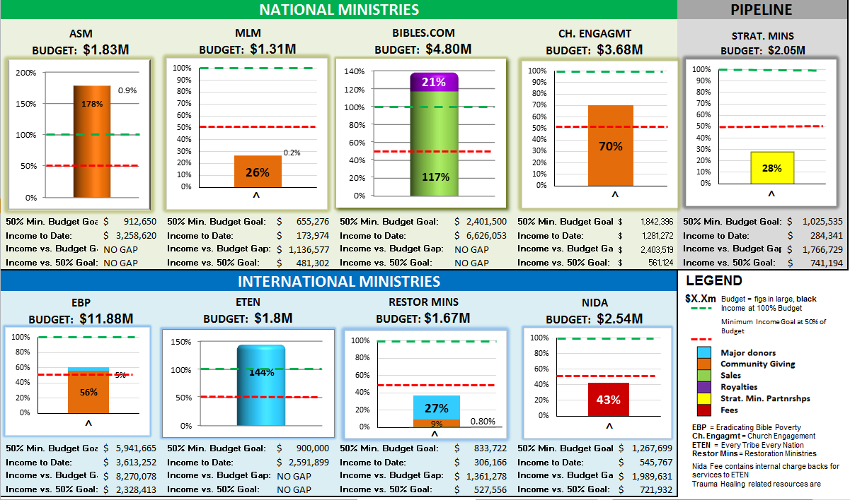
FY14 Actual Income Summary:
As of March 31, 2014
Notes:
Preliminary figures as of December 31, 2013

Slide 4
GSM Communications
Notes:
INTRODUCTION
Since May 2012, the GSM EVP’s has been communicating on a regular basis with key audiences in order to inform, enthrall and activate them with stories about our projects and programs and the diligent Scripture outreach work undertaken by of our Community of Practice.

Slide 5
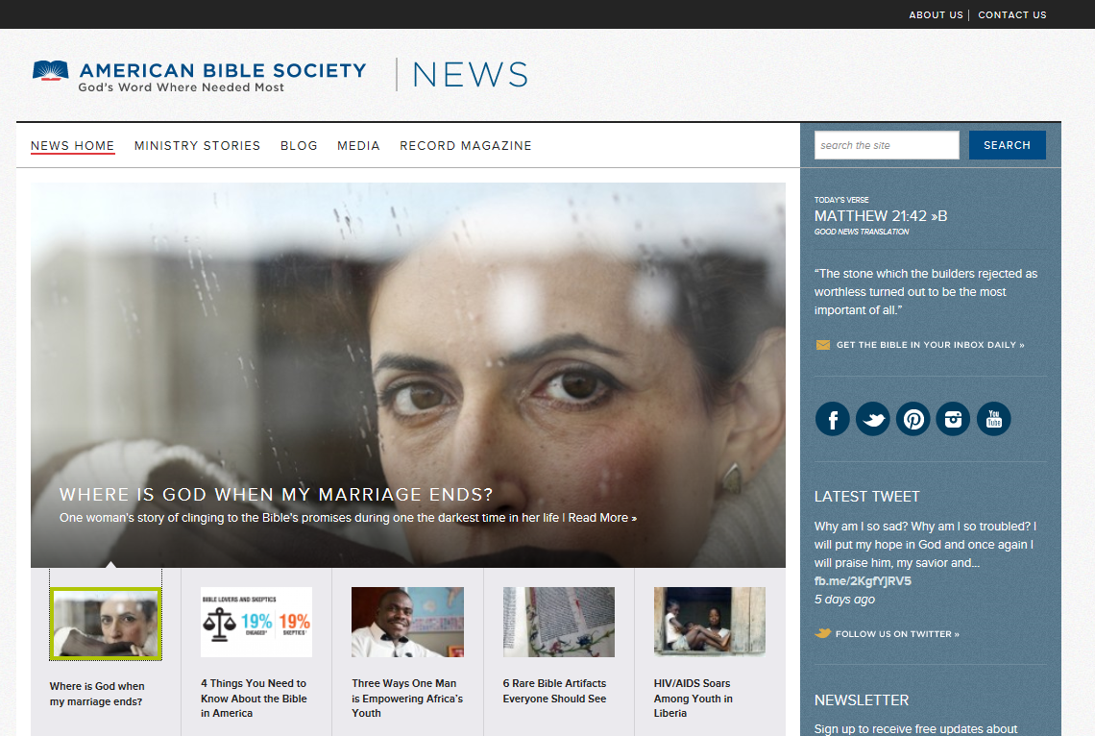
GSM Communications is now news.americanbible.org
Notes:
As of April 11, GSM Communications is now housed with Drew’s team, and all stories go out in the president’s name instead of Bob’s.

Slide 6
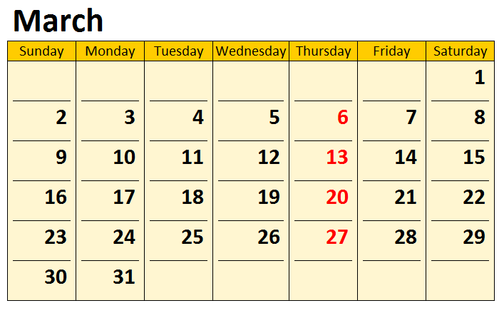
GSM Communication: Frequency
Notes:
Quick reminder of how we have been communicating since May 2012.
Each Thursday the GSM EVP would write to his target audience via a brief e-mail newsletter that GSM Operations would send out in his name.

Slide 7
GSM Communications
PRIMARY
SECONDARY
TERTIARY
Abs Board (19)
MasterWorks (8)
Staff (193)
COP (44)
DeMoss Group (1)
Notes:
Here was his audience:
Primary Audience: 63 people
19 x ABS Board of Trustees (via Kim Nofal).
44 x Community of Practice (ministry partners, alliance partners, Church leaders, para-church leaders, Bible Society leaders)
Secondary Audience: 193 people
193 x All ABS Staff
of which 10 were Philanthropic Advisors (for major donors)
Tertiary Audience: 9 people
8 x MasterWorks (for direct mail fundraising campaigns
1 x DeMoss Group (for public relations releases)

Slide 8
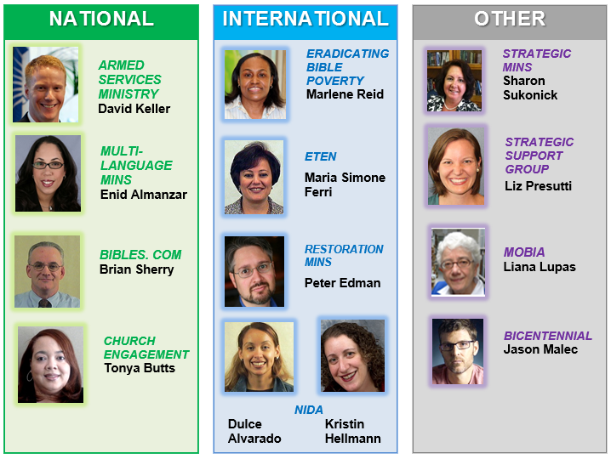
GSM Communications: Ambassadors
Notes:
These story leads were sent to GSM Operations by ABS’s 13 Story ambassadors...
Although these folks no longer send stories to GSM Operations, we have recommended that Drew and his team to continue working closely with them for raw and draft stories as they are the subject matter experts for their ministry units.

Slide 9
GSM Communications: Vehicles
Ministry
News
News
Briefing
Ministry
Profile
Ministry
Blog
Notes:
COMMUNICATION VEHICLES & FREQUENCY
So each week the audiences received one e-mail newsletter titled the ABS News Briefing in the name of the GSM EVP via an online e-mail marketing software. This contains links to stories in the form of one or more of the following communication vehicles:
MINISTRY NEWS
MINISTRY PROFILE
MINISTRY BLOG

Slide 10
GSM Communications: News Briefing
Introductory paragraph
Links to stories
Notes:
News Briefing
This was a one-page newsletter that is sent out via MailChimp each week to the various audiences identified above.
It contained an introductory paragraph in Bob’s name and up to three story links.
These links allow the audience to read that week’s Ministry News, Ministry Profile and Ministry Blog.

Slide 11
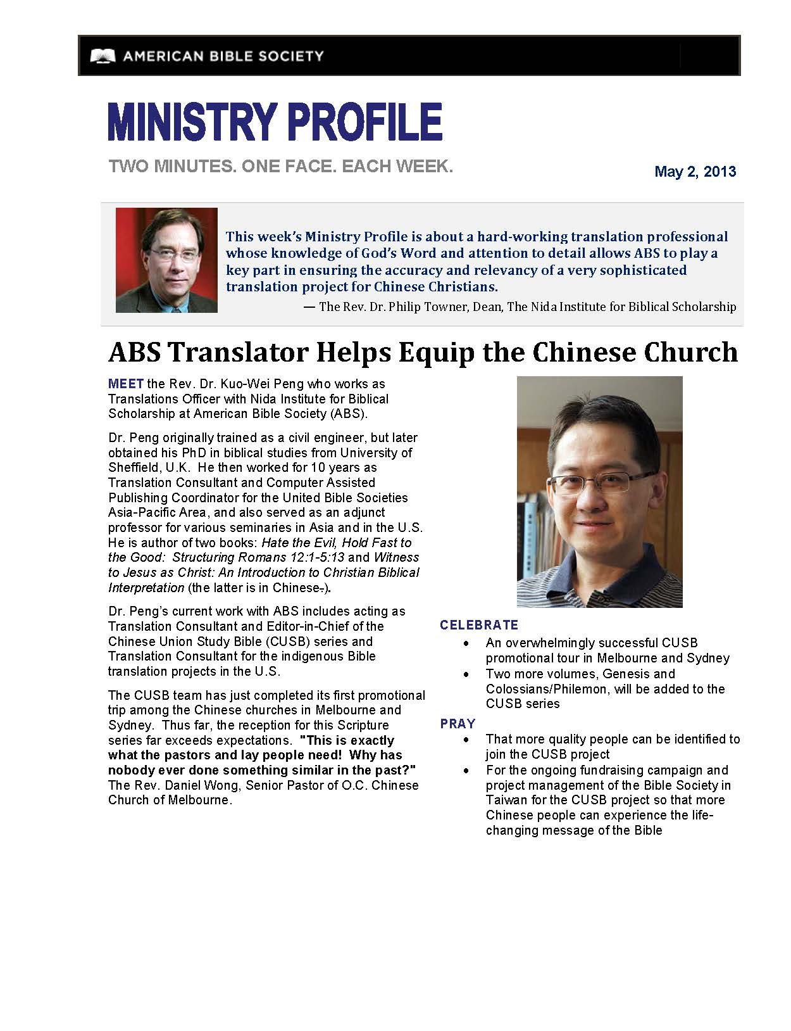
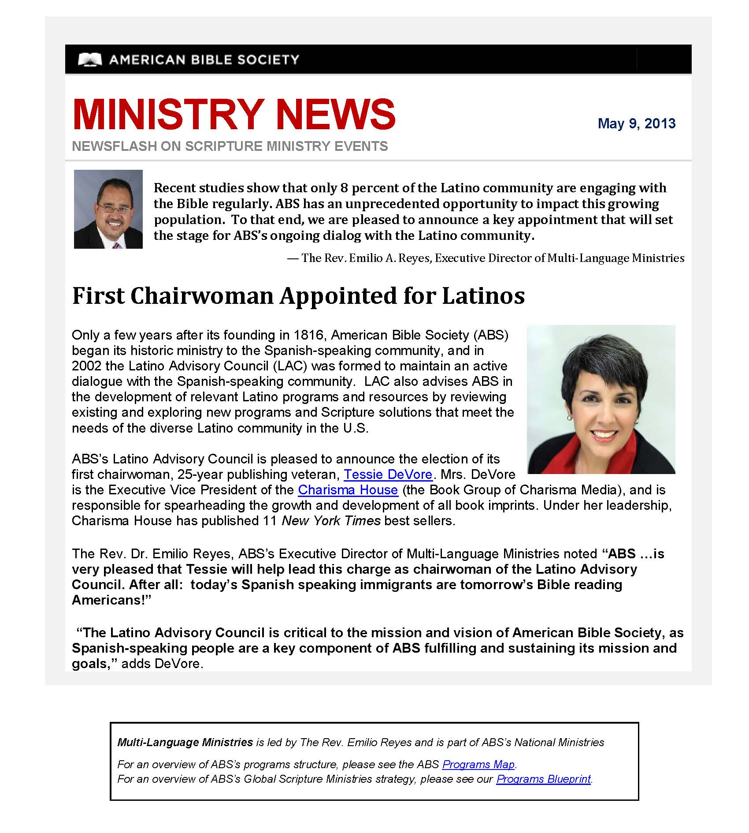
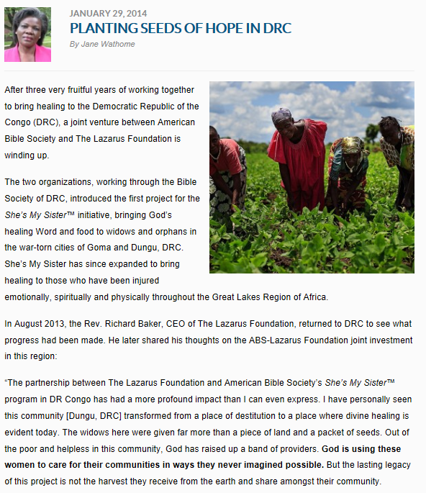
Notes:
I think you are all familiar with the various forms of communications that we have been sending out on behalf of the GSM EVP.
All of these stories are still housed on the GSM Blog site and are available for you to read and share.
Visit gsmblog.americanbible.org

Slide 12
ABS News Briefing
Audience Tracking
Industry Standard:
Open rate 17.5%
Click rate 2.6%
Audience | Readers | Opens | Clicks
ABS Staff | 193 | 45% | 20%
Community of Practice | 44 | 42% | 11%
MasterWorks | 8 | 47% | 17%
DeMoss Group | 1 | 79% | 36%
Notes:
And a quick word about the popularity of Bob’s communications:
Throughout our two years in sending out News Briefings, our Open rates were more than double, and in some cases three times higher than the industry standard of 17.5%
And our Click rates were multiple times higher than the industry standard of 2.6%
(NOTE: The ABS Staff e-mail included Kim Nofal who forwarded our weekly communications to the Board of Trustees)

Slide 13
Notes:
END

